Slide 1
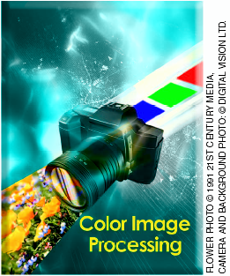
Color Image
Processing
老 師 : 楊 士 萱 博士
學 生 : 陳 柏 源 碩一

Slide 2
Outline
Image processing flowchart in a DSC
Sensor,Aperture,and Lens
Preprocessing
White Balance
Demosaicking
Color Transformation
Postprocessing
Display/archive

Slide 3
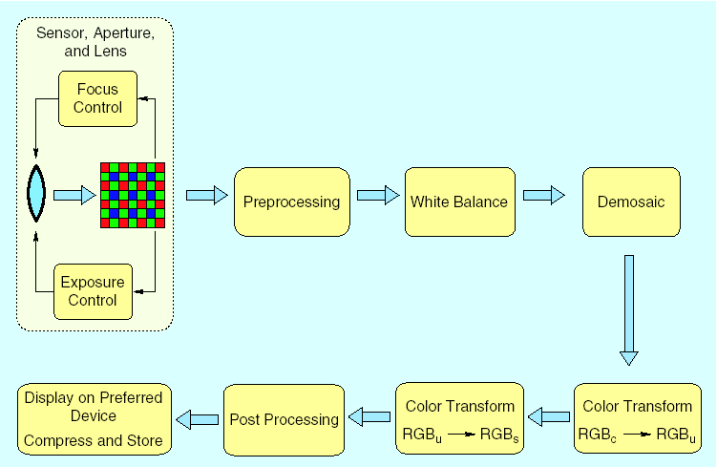
Image processing flowchart in a DSC(1/2)

Slide 4
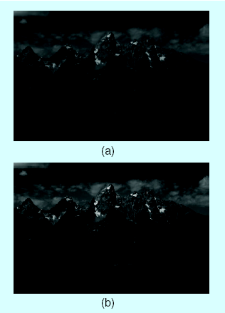
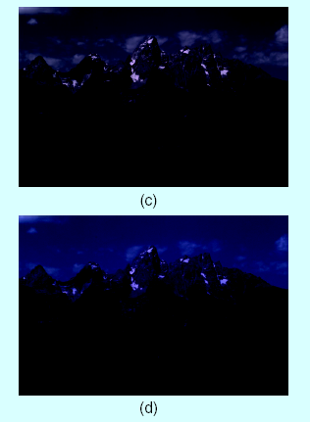
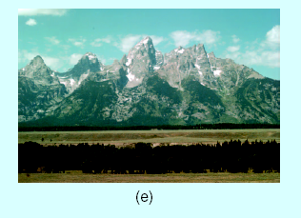
Image processing flowchart in a DSC(2/2)
Raw image
Preprocessing
/ White balance
(c) Demosaicking
(d) Trans. ISO-RGB
(e) Trans. sRGB

Slide 5
Sensor,Aperture,and Lens(1/6)

Slide 6
Sensor,Aperture,and Lens(2/6)
CFA(Color Filter Array)
Exposure control
Focus control

Slide 7
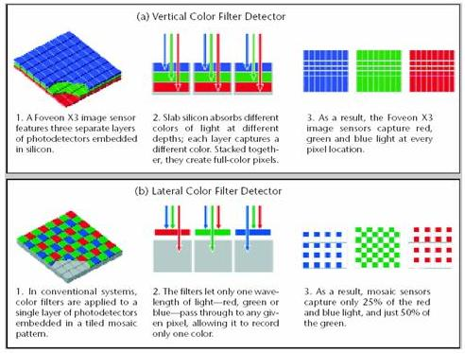
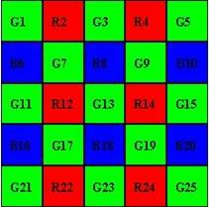
Sensor,Aperture,and Lens(3/6)
CFA(Color Filter Array)
Bayer array

Slide 8
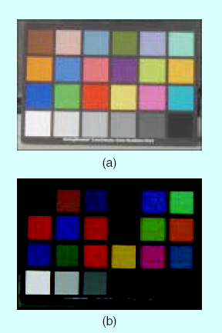
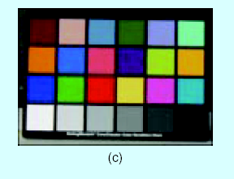
Sensor,Aperture,and Lens(4/6)
Exposure control
Underexposed image
(b) Overexposed image
(c) Well-exposed image

Slide 9
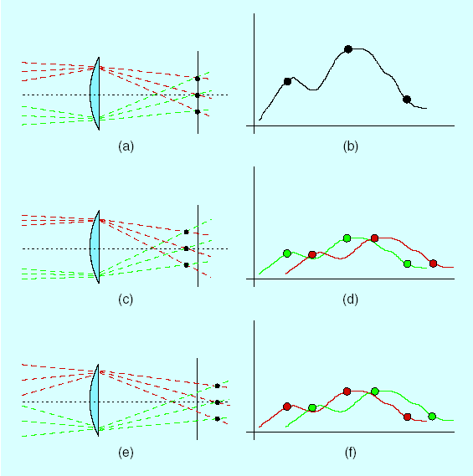
Sensor,Aperture,and Lens(5/6)
Focus control
Object is in good focus
(b) The corresponding intensities
on the image plane
(c) Object is in front of the image
plane
(d) The corresponding intensities
on the image plane
(e) Object is closer to the lens behind
the image plane
(f) The corresponding intensities
on the image plane

Slide 10
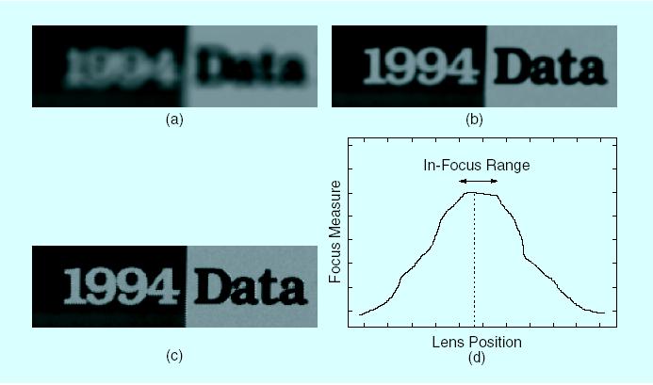
Sensor,Aperture,and Lens(6/6)
Focus control
Out-of-focus
(b) Lens position closer to
the required focal length
(c) An in-focus image block
(d) A plot of the focal measure
versus the lens position

Slide 11
Preprocessing(1/5)

Slide 12
Preprocessing(2/5)
Linearization
Dark current compensation
Flare compensation

Slide 13
Preprocessing(3/5)
Linearization
Some cameras require that data be linearized since the
captured data resides in a nonlinear space
Cameras that include correction for nonlinear data use
an opto-electronic conversion function (OECF)

Slide 14
Preprocessing(4/5)
Dark current compensation
A dark current signal is recored,which is due to thermally
generated electrons in the sensor substrate
Place an opaque mask along the adges of the sensor to give
an estimate of intensity due to dark current alone
capture a drak image for the given exposure time

Slide 15
Preprocessing(5/5)
Flare compensation
To subtract from the whole image a percentage of the
mean measured signal energy in a channel
To subtract a fixed percentage of the mean signal energy
in the pixel’s neighborhood

Slide 16
White Balance(1/3)

Slide 17
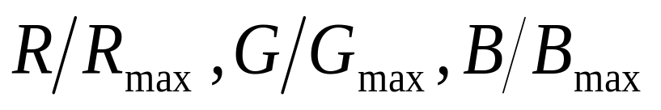
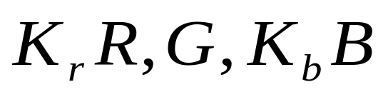
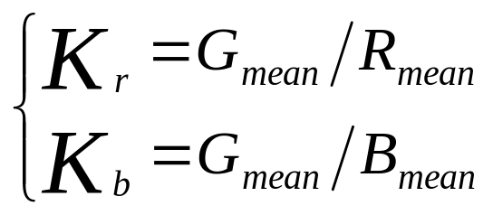
White Balance(2/3)
<1>
<2>
“gray world”

Slide 18
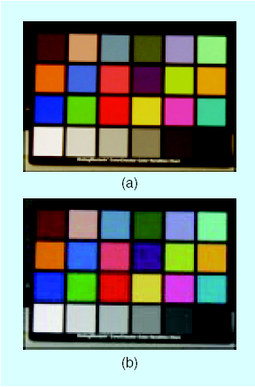
White Balance(3/3)
Image captured under an
incandescent illuminant
(b) Same image after white balance
using the gray world assumption

Slide 19
Demosaicking(1/2)

Slide 20
Demosaicking(2/2)
Raw image -> full color image
  Non-Adaptive algorithm
  Adaptive algorithm

Slide 21
Color Transformation(1/2)

Slide 22
Color Transformation(2/2)
Unrended Color Spaces
  convenient storage or calculation
  CIEXYZ (ISO-RGB , RIMM-RGB)
Rended Color Spaces
  are designed for output purpose
  sRGB

Slide 23
Postprocessing(1/2)

Slide 24
Postprocessing(2/2)
Edge enhancement
  the demosaicking step may introduce a zipper
artifact along intensity edges
Coring(thresholding)
  Is used to remove detail information that has no significant
  contribution to image detail and behaves much like noise

Slide 25
Display/archive(1/2)

Slide 26
Display/archive(2/2)
Display
  CRT - additive color system
  printer - CMYK color space
Archive
  TIFF/EP
  EXIF,JPEG
  JPEG2000

